Slide 1
Digital Portfolio
STUDENT NAME: Iniya Jazlynn J
REGISTER NO : 2428C0475
NMID :C473A70EC74AF0A90874C72286A72F04
DEPARTMENT : BSc. Artificial Intelligence and Machine Learning
COLLEGE : KPR College of Arts Science and Research
UNIVERSITY : Bharathiar University

Slide 2
PROJECT TITLE
PhD Thesis Showcase Portfolio

Slide 3


AGENDA
Problem Statement
Project Overview
End Users
Tools and Technologies
Portfolio design and Layout
Features and Functionality
Results and Screenshots
Conclusion
Github Link
3/21/2024 Annual Review

Slide 4

PROBLEM STATEMENT
In today’s academic world, traditional thesis documents alone are insufficient to showcase a researcher’s journey and contributions. Researchers often struggle to present:
Their thesis work in an interactive and professional way.
Publications and findings in a structured format.
A clear overview of research methodology and results.
There is a need for a digital showcase portfolio that highlights:
Thesis content
Research contributions
Achievements
Publications all in a modern, accessible format.

Slide 5

PROJECT OVERVIEW
The PhD Thesis Showcase Portfolio is a personal web-based platform designed to:
Present my thesis details, methodology, and results.
Showcase research highlights, publications, and academic contributions.
Include timeline and contact details in a professional format.
Provide a live portfolio website accessible via GitHub Pages.
Built using HTML, CSS, and JavaScript, the portfolio ensures a clean, modern, and responsive design.

Slide 6

WHO ARE THE END USERS?
Students & Research Scholars:
To present their academic journey.
Supervisors & Examiners:
For thesis evaluation and easy access.
Recruiters & Employers:
To evaluate academic and technical expertise.
Peers & Mentors:
To review and give feedback on research work.
General Audience:
Anyone interested in exploring research contributions.

Slide 7

TOOLS AND TECHNIQUES
Frontend:
HTML5 → For structure and content
CSS3 → For styling and responsiveness
JavaScript → For interactivity
2) Development Environment:
Visual Studio Code
3) Version Control & Deployment:
Git & GitHub → Code management and live hosting (GitHub Pages)

Slide 8
PORTFOLIO DESIGN AND LAYOUT
Header → Thesis Title, Name, Affiliation.
Navigation Bar → Quick access to sections.
About Section → Thesis background and objectives.
Research Highlights → Chapters & key contributions.
Publications Section → Journals, Conferences, DOI links.
Timeline → PhD journey year by year.
Contact Section → Email, LinkedIn, Google Scholar, Thesis PDF.
Footer → Copyright and acknowledgment.
8

Slide 9
FEATURES AND FUNCTIONALITY
Responsive Design → Works on desktop, tablet, mobile.
Interactive Navigation → Smooth scrolling and fixed navbar.
Research Highlights → Cards for Introduction, Methodology, Results.
Publications Showcase → With links to papers/PDFs.
Timeline → Visual representation of research journey.
Contact Form → For communication & collaboration.
Modern UI Elements → Hover effects, clean typography, professional layout.
Easy Deployment → Hosted live via GitHub Pages.

Slide 10
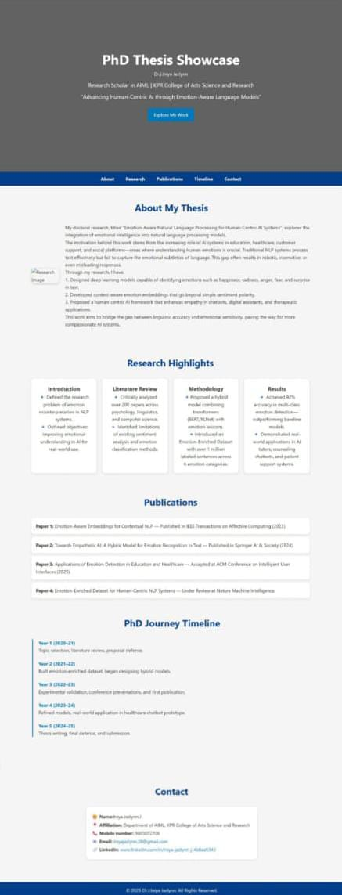

RESULTS AND SCREENSHOTS
A fully functional PhD Thesis Showcase
Portfolio website was developed.
Sections include About, Research Highlights,
Publications, Timeline, Contact.
Responsive and professional layout.
Interactive features enhance usability.
3/21/2024 Annual Review
10

Slide 11
CONCLUSION
The PhD Thesis Showcase Portfolio provides an innovative, digital, and professional platform to present academic work.
Goes beyond traditional thesis submission.
Highlights research contributions, publications, and academic journey.
Helps researchers in personal branding, academic recognition, and professional opportunities.
Easily shareable and accessible worldwide.
11

Slide 12
Github link
https://iniya-jazlynn.github.io/portfolio/

